Slide 1
Automated Pneumonia and COVID-19 Detection from Chest X-Ray Images
Rajib Roy
M.Tech. (AI) | SR No: 24459 | IISc Bengaluru
DS 216o: Applied AI in Healthcare
April 2026

Slide 2
PROBLEM STATEMENT
Primary Objective
• 3-class chest X-ray classification: Normal / Pneumonia / COVID-19
• Enable automated, scalable screening to assist radiologists
Secondary Objectives
• Uncertainty quantification (MC Dropout) — auto-refer low-confidence cases
• Visual explainability via Grad-CAM heat-maps on each model
• Deployment as interactive Streamlit web application
Key Challenges
• Class imbalance — COVID accounts for only ~13.4% of data
• Multi-source datasets requiring unified label mapping and deduplication
• Clinical interpretability: model decisions must be explainable
• Uncertainty must be communicated to avoid confident wrong predictions

Slide 3
METHODOLOGY
Model Architectures (ImageNet pretrained)
• DenseNet121 — 7.2M params — dense skip connections
• ResNet50 — 24.0M params — residual connections
• EfficientNetB0 — 4.3M params — compound scaling
– Shared head: BN→Drop→FC(f,256)→ReLU→BN→Drop→FC(256,3)
Two-Phase Transfer Learning
• Phase 1 (5 ep, lr=1e-3): frozen backbone — train head only
• Phase 2 (≤20 ep, lr=1e-5): unfreeze last block + joint fine-tuning
– EarlyStopping (patience=5), ReduceLROnPlateau, ModelCheckpoint
Loss & Class Balancing
• Focal Loss (γ=2, α=0.25) + inverse-frequency class weights
– COVID weight = 2.49× (vs Normal=0.77, Pneumonia=0.77)
Ensemble + Explainability
• AUC-weighted soft voting across all 3 models
• MC Dropout (50 passes): refer if combined uncertainty > 0.35
• Grad-CAM on last conv block — heat-maps overlaid on CXR
Pipeline Overview
► Raw CXR images (Kermany + COVID-19 DB)
► Unify labels → deduplicate → 80/10/10 split
► Augmentation + ImageNet normalisation
► Phase 1: train head (backbone frozen)
► Phase 2: fine-tune last block + head
► Ensemble: AUC-weighted soft voting
► MC Dropout → uncertainty → referral flag
► Grad-CAM → saliency heat-map overlay
► Streamlit app: single & batch inference

Slide 4
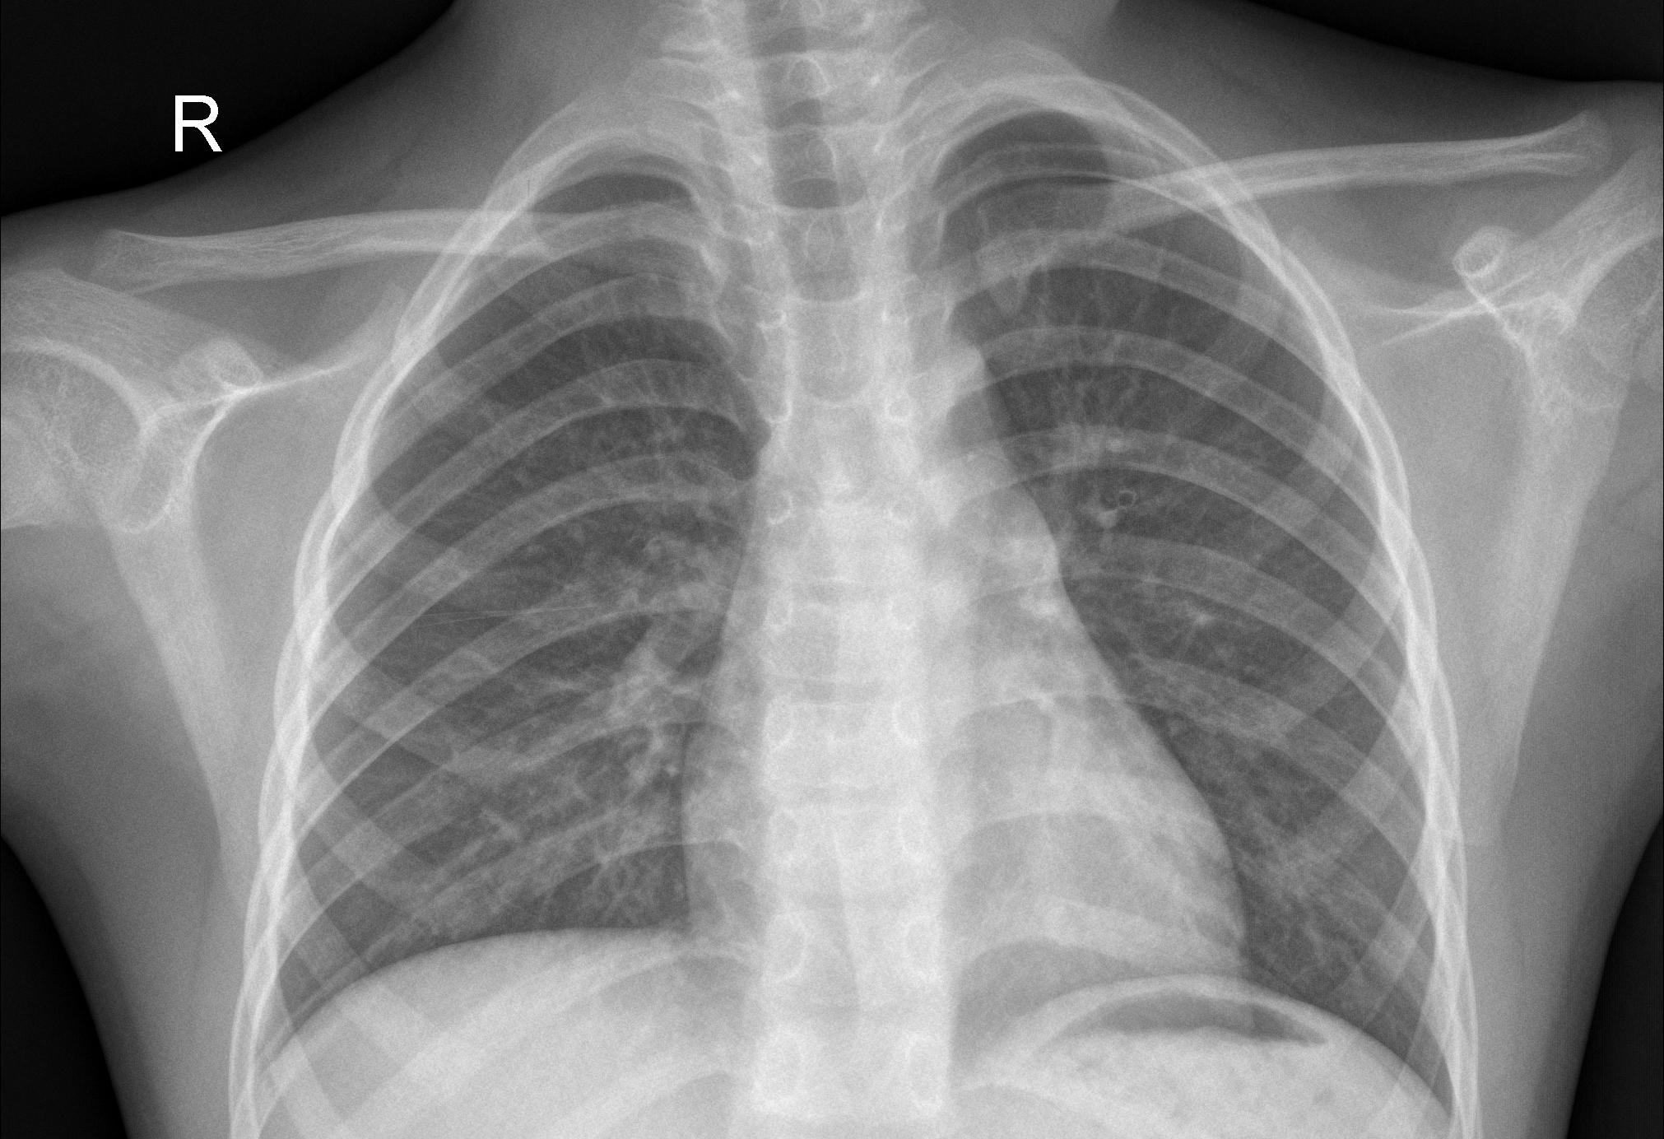
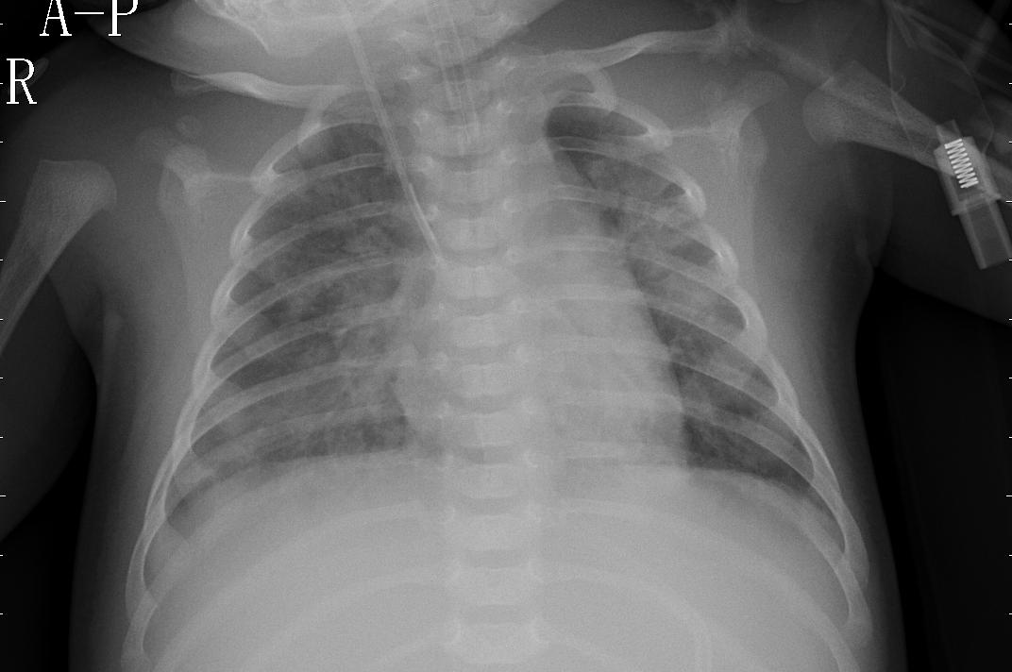
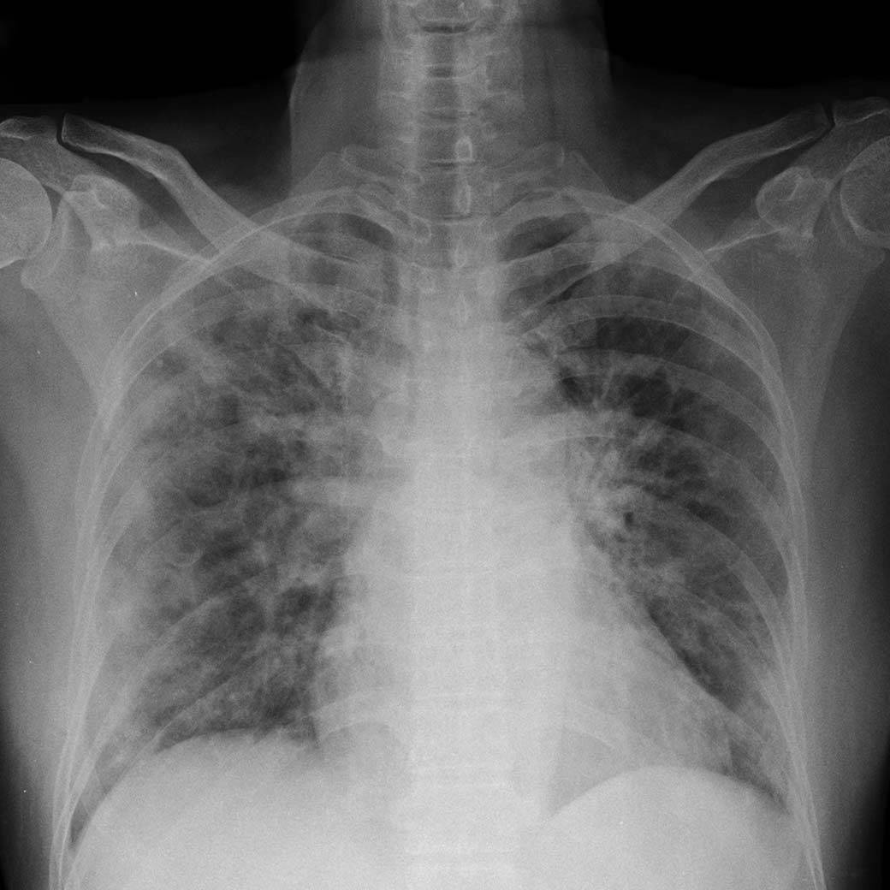
DATASET
Sources
• Kermany Chest X-Ray (Kaggle) — 5,863 images | Classes: Normal, Pneumonia
• COVID-19 Radiography Database (Kaggle) — 21,165 images | Classes: COVID, Viral Pneumonia, Lung Opacity, Normal
After hash-based deduplication → 27,005 unique images
• 80 / 10 / 10 stratified split | Train: 21,604 | Val: 2,700 | Test: 2,701
• Normal: 11,767 | Pneumonia: 11,622 | COVID: 3,616 (≤13.4% — minority class)
Preprocessing
• Resize to 224×224 | ImageNet normalisation | Train augmentation: H-flip, ±15° rotation, affine
Normal
Pneumonia
COVID-19

Slide 5
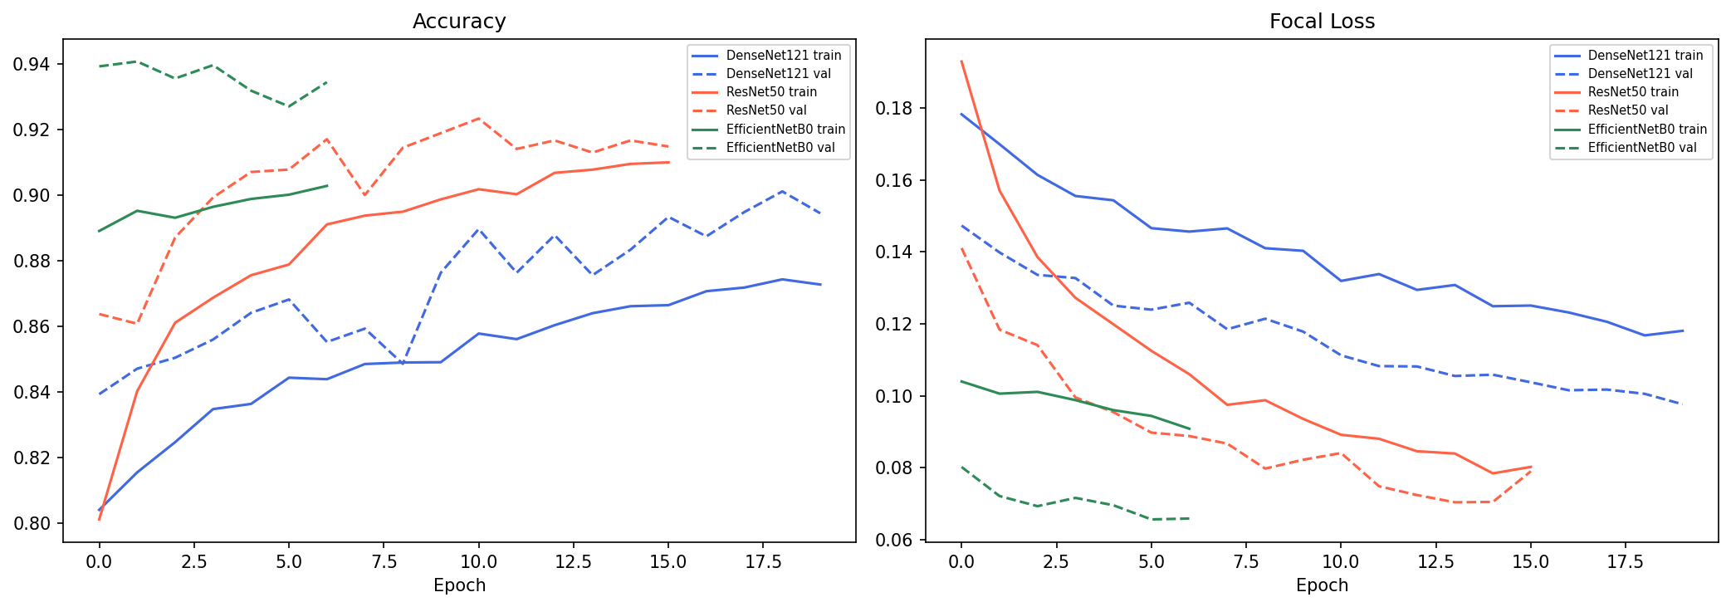
EXPERIMENTS
Hardware & Setup
• NVIDIA RTX 3060 Laptop (6 GB VRAM), CUDA 12.4 | PyTorch + mixed precision (torch.cuda.amp)
• Batch size: 32 | Image size: 224×224 | Optimizer: Adam
Phase Results
• Phase 1 final val-acc — DenseNet121: 79.1% ResNet50: 79.6% EfficientNetB0: 86.6%
• Phase 2 best val-acc — DenseNet121: 90.1% ResNet50: 92.3% EfficientNetB0: 94.1%
– EarlyStopping triggered: ResNet50 at Phase-1 ep 4 and Phase-2 ep 16; EfficientNetB0 at Phase-2 ep 7
Fig: Training & validation loss/accuracy across Phase 1 and Phase 2 for all three models

Slide 6
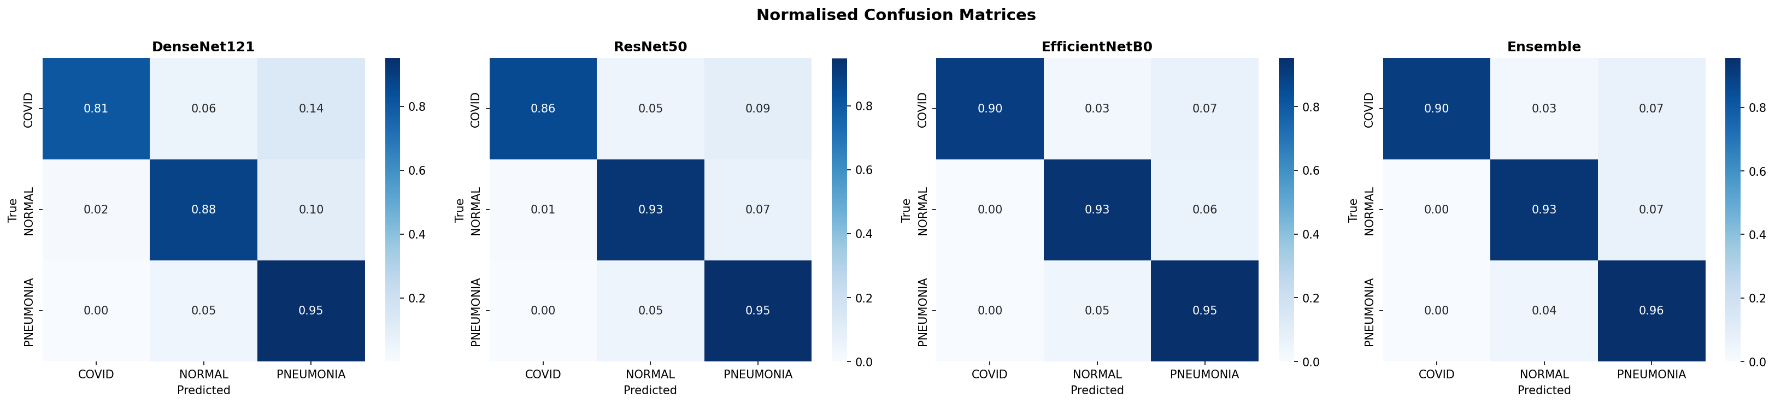
RESULTS WITH VISUAL OUTPUTS
Model | Accuracy | Macro AUC | Macro F1 | F1-COVID
DenseNet121 | 90.19% | 0.9814 | 0.8937 | 0.8678
ResNet50 | 92.63% | 0.9875 | 0.9232 | 0.9131
EfficientNetB0 | 93.67% | 0.9900 | 0.9376 | 0.9407
Ensemble | 93.74% | 0.9908 | 0.9396 | 0.9465
High-confidence subset (55.2% of test set, threshold=0.35): 99.40% accuracy
Fig: Normalised confusion matrices — DenseNet121, ResNet50, EfficientNetB0, Ensemble

Slide 7
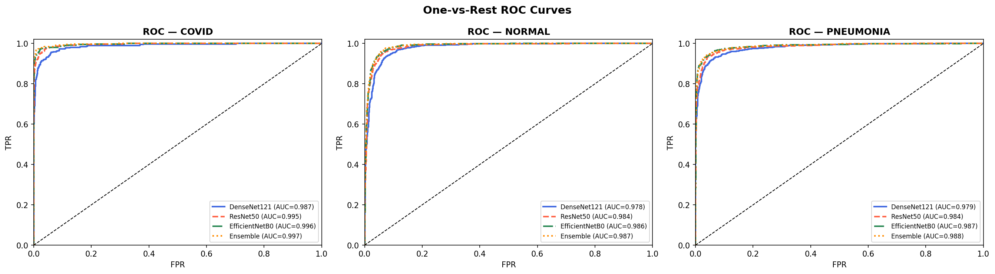
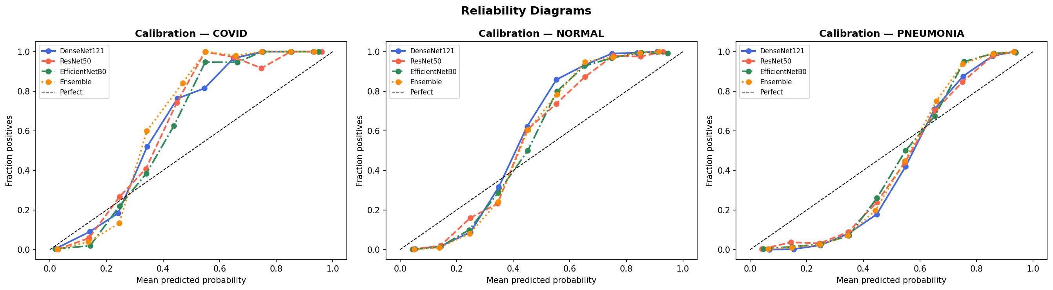
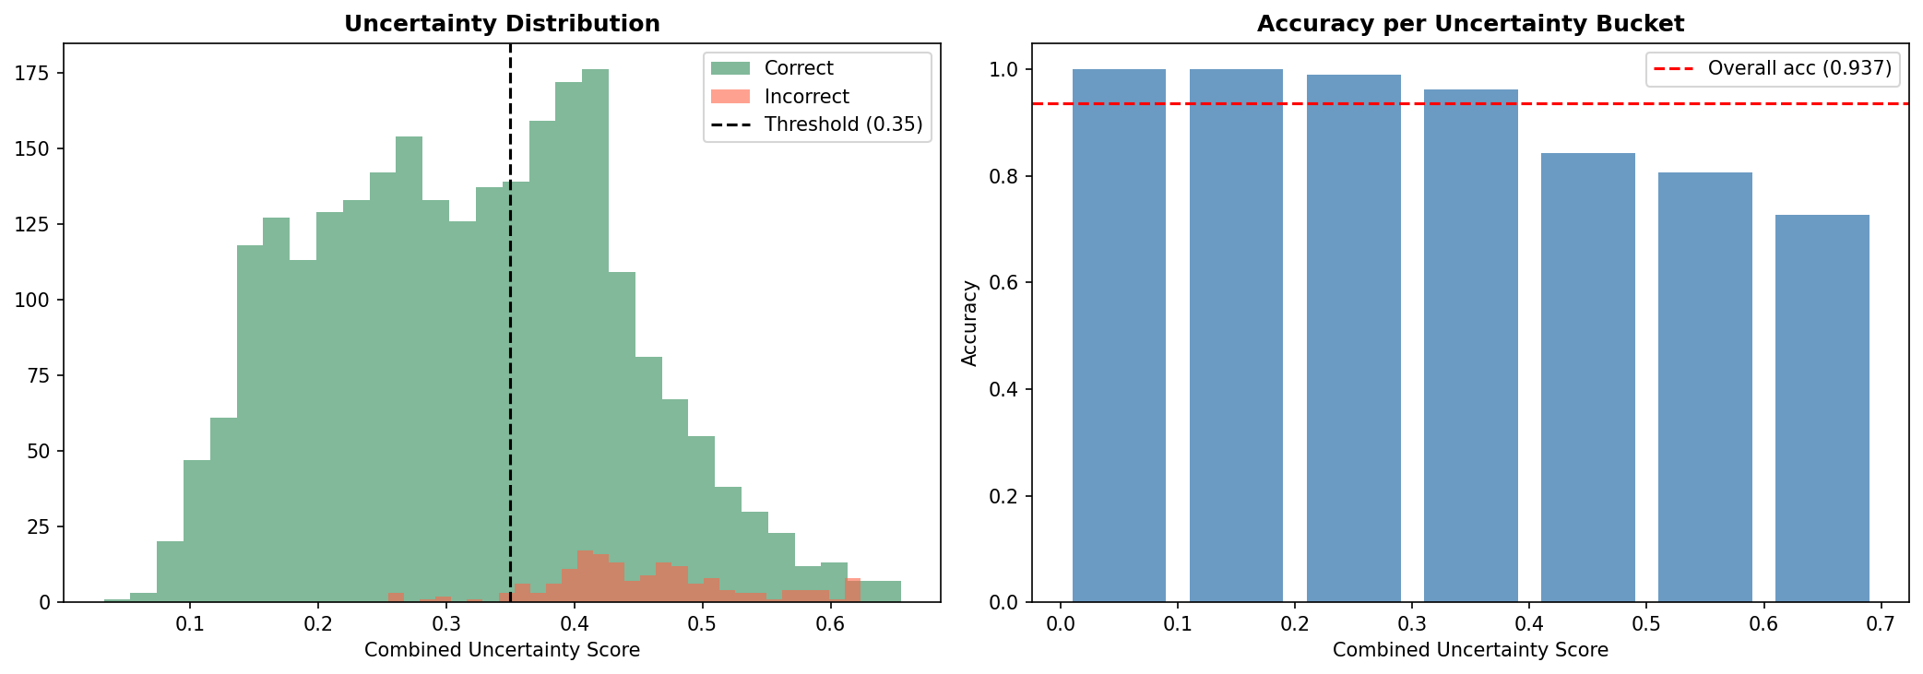
VISUAL ANALYSIS — CALIBRATION & EXPLAINABILITY
One-vs-Rest ROC Curves (per class, all models)
Calibration (Reliability) Diagrams — all models & ensemble
MC Dropout Uncertainty — correct vs misclassified (threshold=0.35)

Slide 8
COMPARISON WITH STATE OF THE ART
Method | Classes | Dataset | Accuracy | AUC | UQ / Explainability
CheXNet (2017) | 14-class | 100K CXR | 90.1% | 0.968 | None
COVID-Net (2020) | 3-class | ~14K CXR | 92.7% | — | None
Minaee et al. 2021 | 2-class | 5K CXR | 98.3% | — | Grad-CAM only
Narin et al. 2021 | 3-class | 4.2K CXR | 98.2% | 0.993 | None
Zhang et al. 2020 | 3-class | 1.4K CXR | 96.0% | 0.994 | Conf. only
Ours (Ensemble) | 3-class | 27K CXR | 93.74% | 0.991 | MC Dropout + Grad-CAM
★ Largest unified 3-class dataset (27K) among compared methods
★ Only method combining uncertainty quantification AND visual explainability
★ Referral mechanism achieves 99.40% accuracy on high-confidence predictions

Slide 9
SUMMARY AND FUTURE WORK
Summary
• End-to-end 3-class CXR classifier on 27,005 images
• Ensemble (DenseNet121 + ResNet50 + EfficientNetB0) – 93.74% accuracy | 0.9908 macro AUC | 0.9396 macro F1
• Focal Loss + class weights handle severe class imbalance
• MC Dropout: 99.40% accuracy on 55.2% high-confidence subset
• Grad-CAM provides radiologist-interpretable saliency overlays
• Deployed as Streamlit app: single & batch inference + CSV export
Limitations
• Two-source dataset
• 44.8% referral rate may be high for real-world triage deployment
Future Work
• Vision-language model for automated radiology report generation
• Reduce referral rate via temperature scaling

